Slide 1
Distribution of the sample vs the sampling distribution

Slide 2
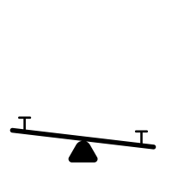

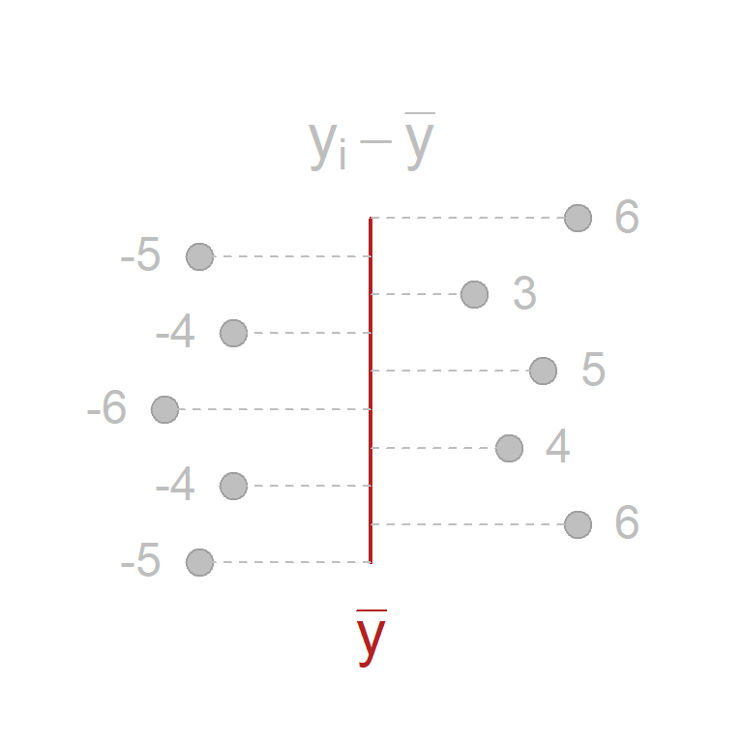
“DEVIATIONS”
are the centerpiece of every variance and the currency of regression models
https://watts-college.github.io//paf-510-template/lectures/caffeine.html

Slide 3
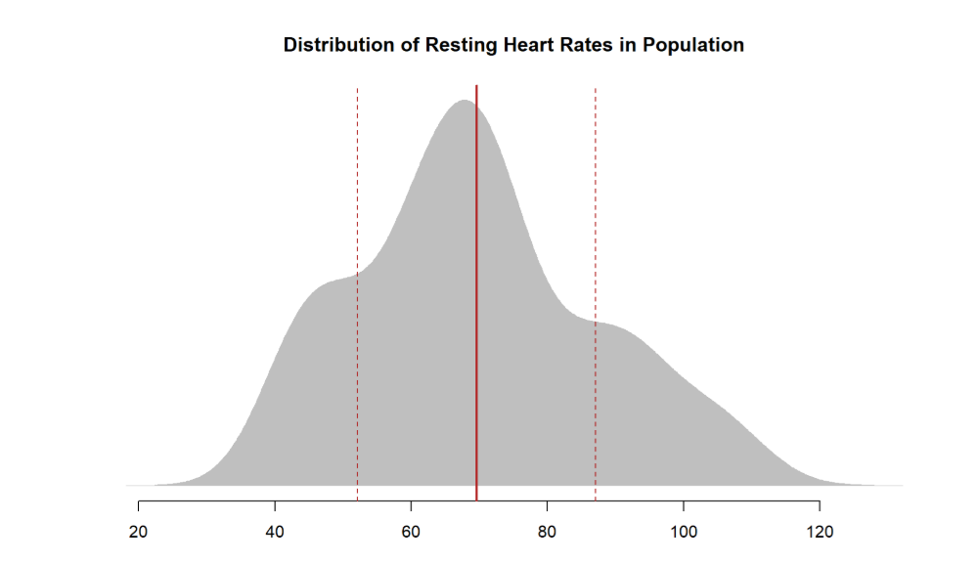
this is SAMPLE VARIANCE

Slide 4
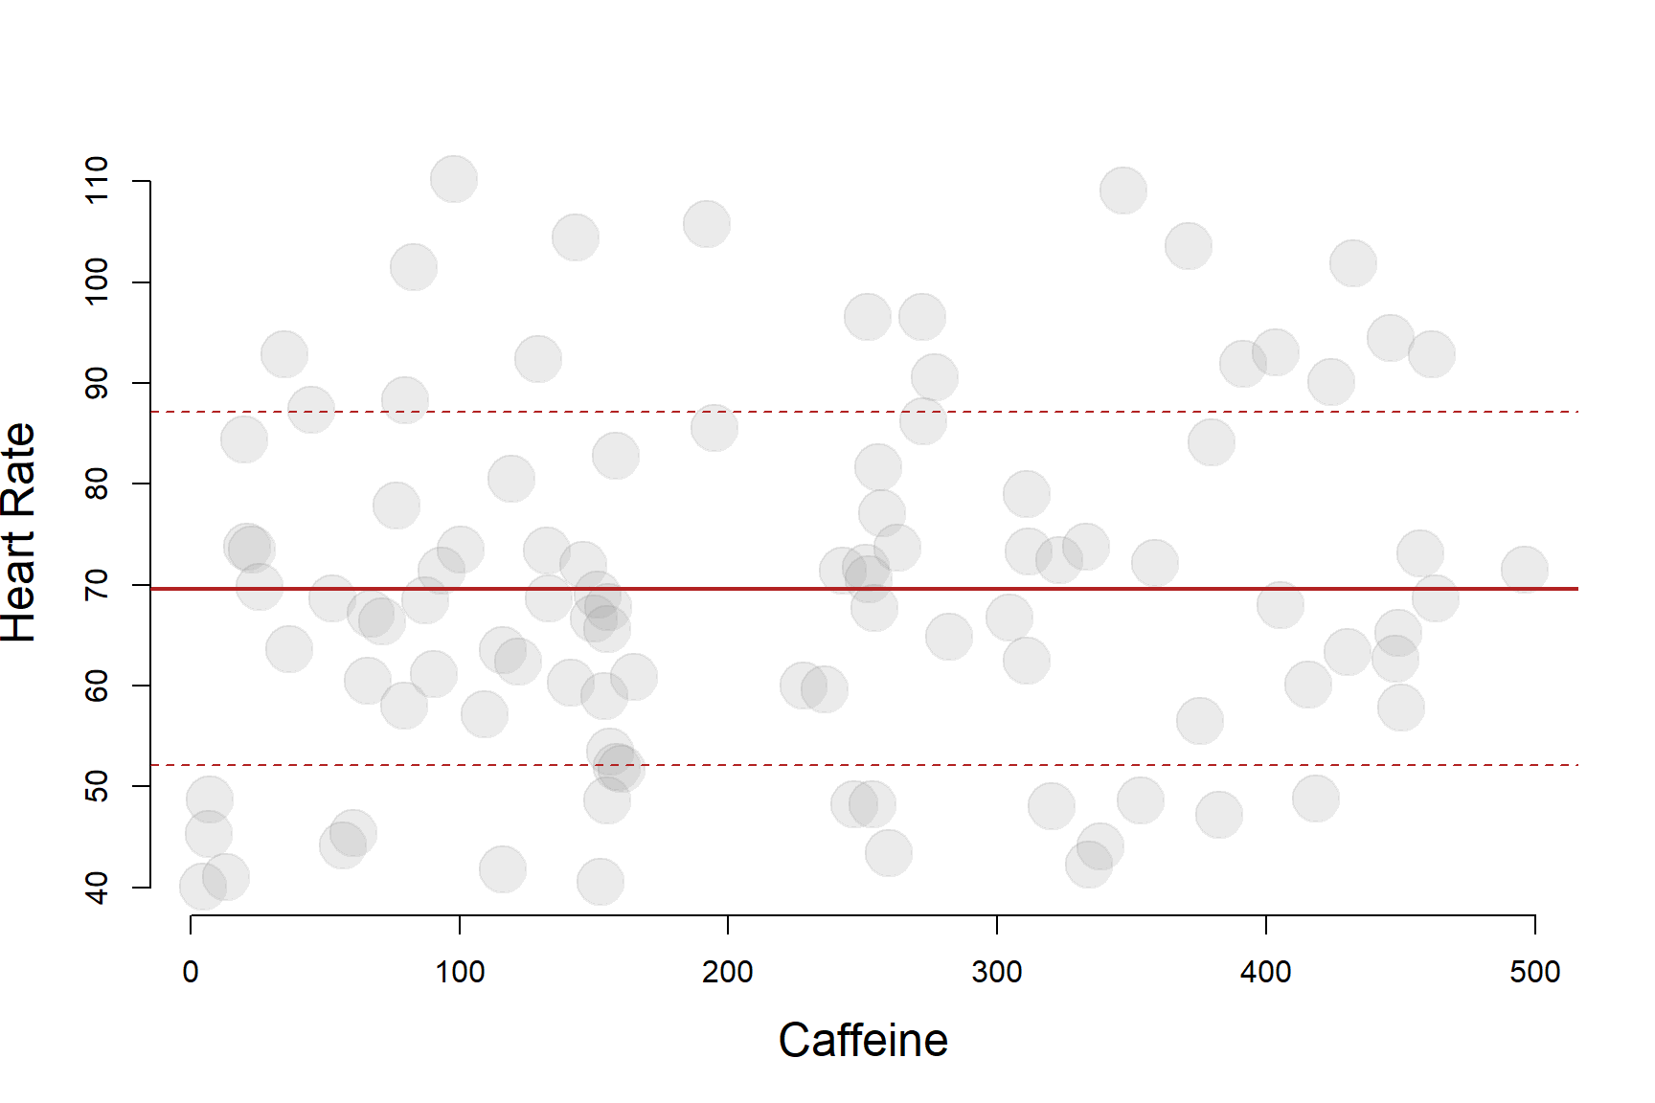
this is SAMPLE VARIANCE

Slide 5
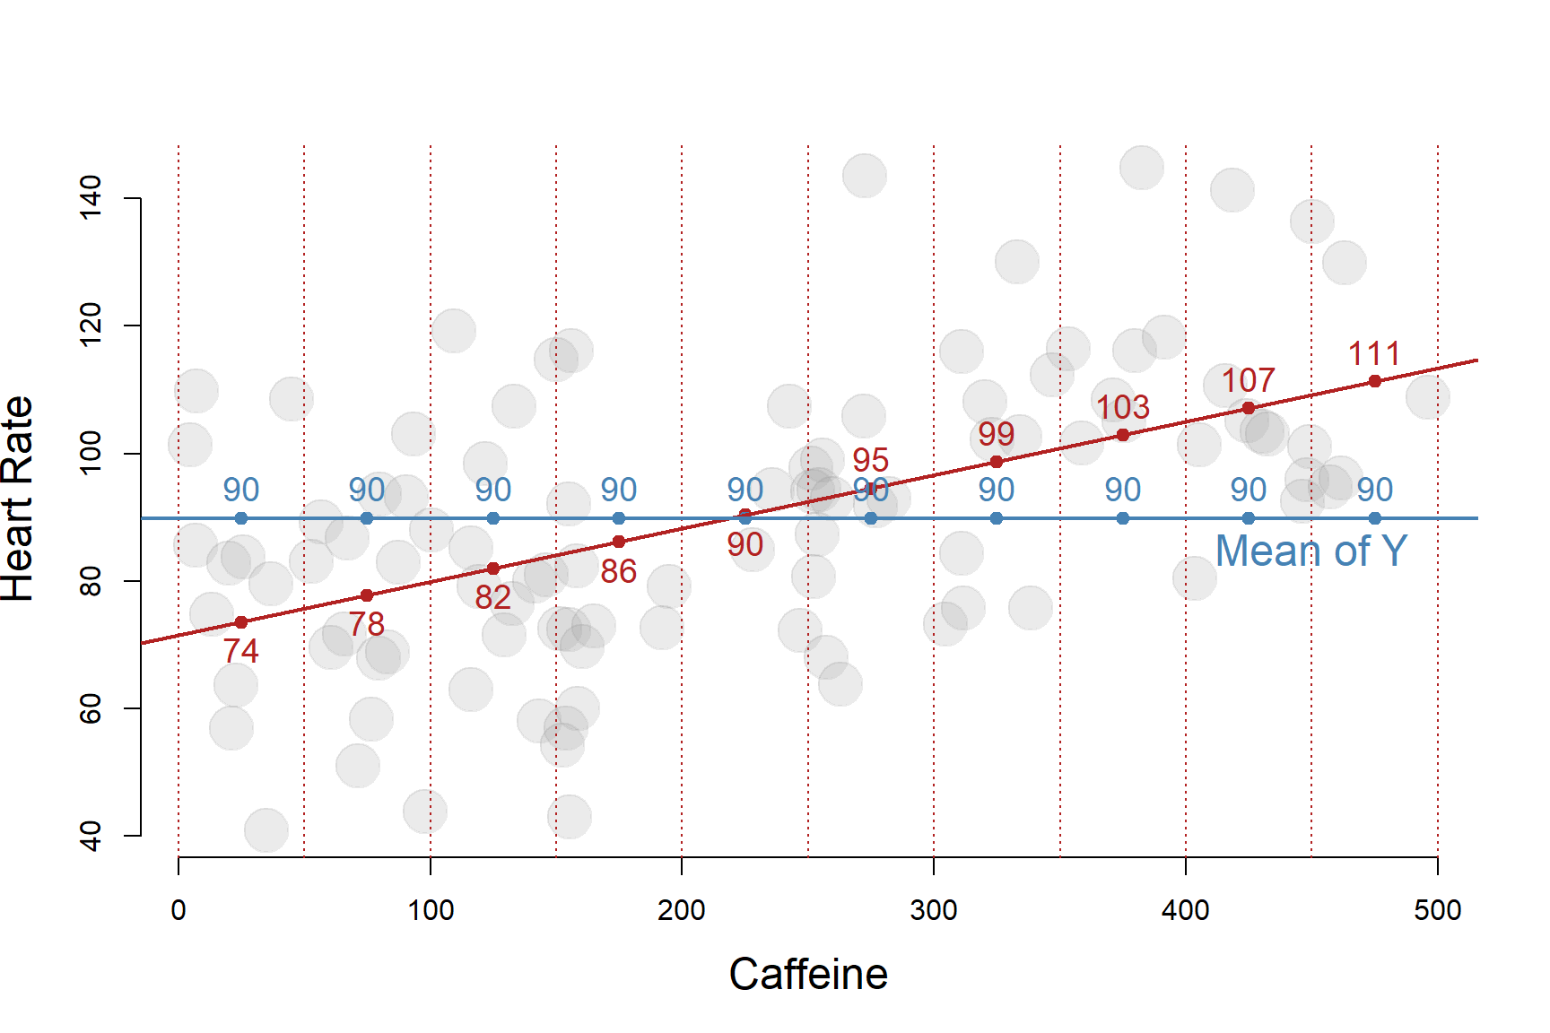

Slide 6
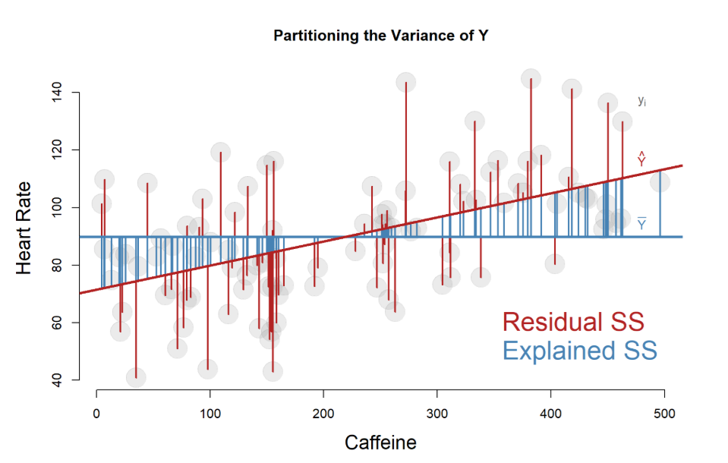

Slide 7
Partitioning the Variance of Y
TSS becomes the
variance of Y
ESS becomes the
variance of the slope

Slide 8
The Central
Limit Theorem

Slide 9
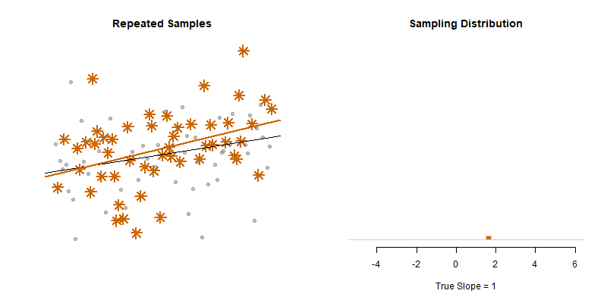
Central Limit theorem:
the sample statistic (the slope)
has a predictable variance
(the standard error)
https://github.com/lecy/regression-simulations

Slide 10



Standard Error of the slope
Point i
$$Y_{i}−{\hat{Y}}_{i}=e_{i}$$
Sum of Squared Error Terms
$$\overline{Y}$$
$$Y_{i}−\overline{Y}$$
Variance of the residual
Standard error of the slope
The standard error of the slope is one of the most important concepts in regression because it determines the size of the confidence interval and thus the statistical significance of our study. We want standard errors to be as small as possible. We see here that the size of the standard error will be directly related to the amount of unexplained variance we have in our model, the residual e. The important thing to note is the unexplained portion shows up in the numerator of the standard error. As a result, the size of the standard error will be proportional to the amount of unexplained variance (plus a couple of other considerations to be covered later).
Standard error: on average, how far off is our estimate (best guess) of the slope from the true slope?

Slide 12
this is SAMPLING VARIANCE
https://github.com/lecy/regression-simulations

Slide 13
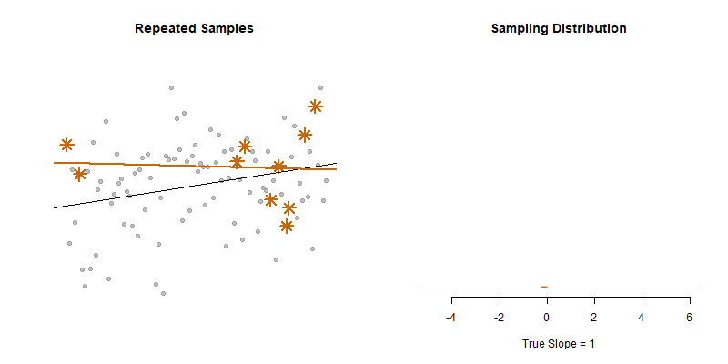
this is SAMPLING VARIANCE
https://github.com/lecy/regression-simulations

Slide 14
this is SAMPLE VARIANCE

Slide 15
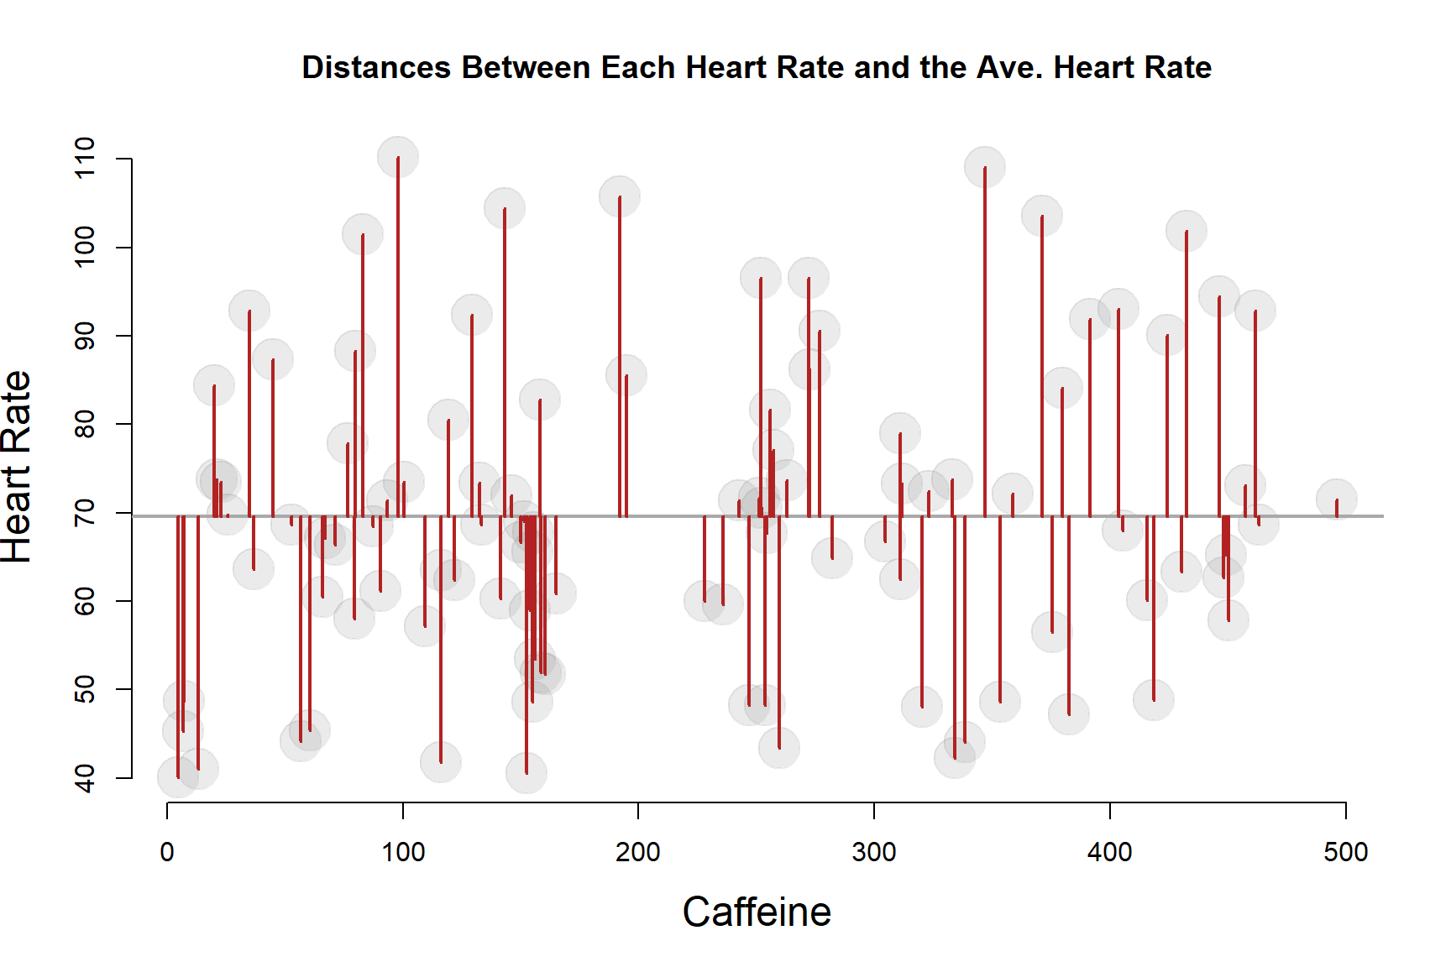
this is SAMPLE VARIANCE

Slide 16
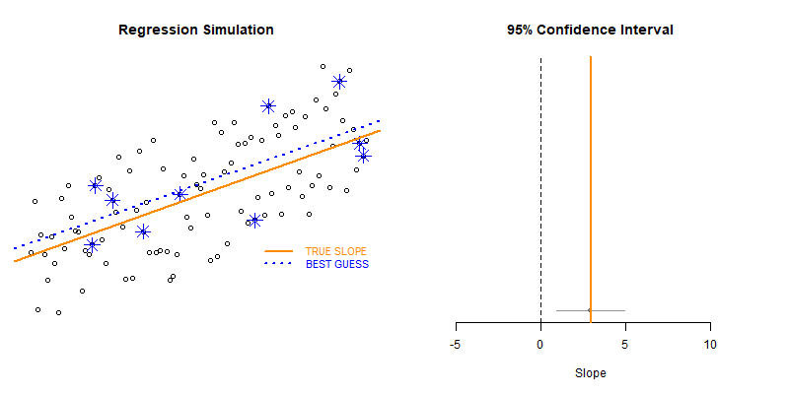
this is SAMPLING VARIANCE

Slide 17
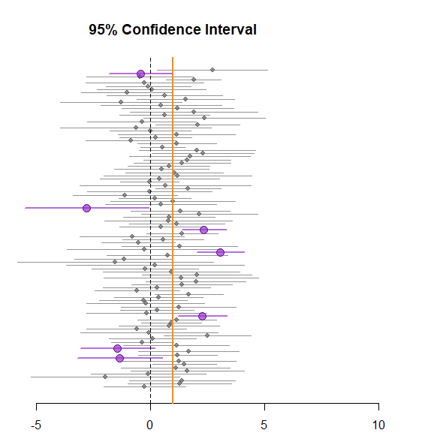
SAMPLE Distribution
Sampling Distribution
variance:
Measured as
Standard
Deviations
Measured as
Standard
Errors
Center of the Data
“True” Slope

Slide 18
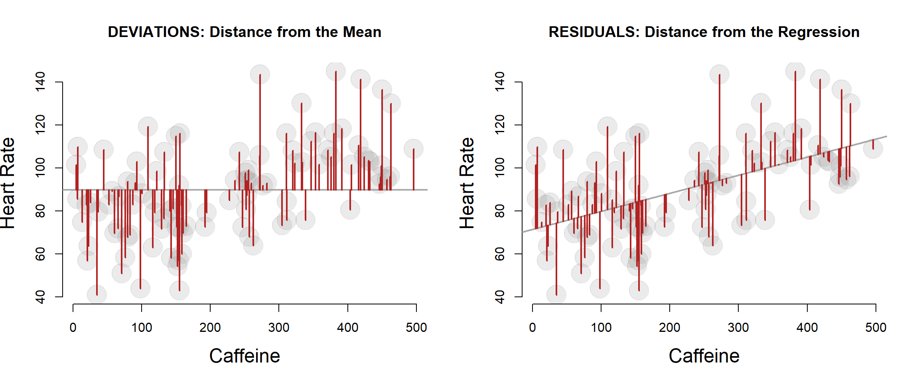
TSS BECOMES
VARIANCE of Y
ESS BECOMES
VARIANCE OF THE SLOPE
Standard deviation: on average, how far is the
mean from each data point
One interpretation of the SD of the residual: on average, how far is the conditional mean
from each data point

Slide 19
Sampling Distribution
More Importantly:
Unexplained Variance
Standard
Error
Confidence
Interval
Error SS
same as
the Residual SS
p-value
“True” Slope

