Slide 1
COUNTERFACTUAL ESTIMATORS

Slide 2
3 valid counterfactuals:
Each variety of counterfactual has a different formula for the program effect estimate.
Pre-Post Reflexive
Estimator
effect = T2-T1
Post-Only
Estimator
effect = T2-C2
Pre-Post w Comparison
Estimator
effect = (T2-T1) – (C2-C1)
(Diff-in-Diff)
effect
effect
A
effect:
A-B
B
t=1
t=2
t=1
t=2
t=1
t=2
Program
Program
Program
Treatment Groups, T1=before, T2=post-program measure
Control Groups, C1=before, C2=post-program measure

Slide 3
b₀ will measure Y-bar of the omitted group C2
b₀ +b₁ represents
the Y-bar of T2
Recall from Unit on Dummy Variable Models
Y = b₀ + b₁(TreatDummy) + e
b₁ = MEAN_{treat} - MEAN_{control}
b₁ = T2 – C2
(basic set-up for a comparison of group means in regression)
Outcome
Treatment
b₁
T2
Control
C2
b₁ = 0
(group means)
The default hypothesis test in the regression then uses b₁ to
test for a meaningful difference between T2 and C2

Slide 4
Difference-in-Difference Estimator
T2
Pre-Post w Comparison
Estimator
effect = (T2-T1) – (C2-C1)
T1
A
effect:
A-B
C2
C1
B
(Diff-in-Diff)
t=1
t=2
Program
Accounts for initial difference in groups and secular trends

Slide 5
Difference-in-Difference Estimator
Pre-Post w Comparison
effect = (T2-T1) – (C2-C1)
effect:
A-B
A
Gains during the program period by treatment group
Gains independent of the program (secular trends)
B
t=1
t=2
Program

Slide 6
T2
T2 – T1 =
Total Gains in
Treatment Group
C2
C2 – C1 =
Total Gains in
Control Group
(trend)
T1
C1
(T2-T1)-(C2-C1) = Program Impact

Slide 7
Difference-in-Difference Estimator
effect = (T2-T1) – (C2-C1)
Two important things to note:
The groups prior to the treatment are not identical. The difference in difference is robust because it does not require equivalent treatment and “control” (comparison) groups.
The comparison group measures the changes we would expect to observe in the treatment group over time independent of the treatment. This assumption must be true for the diff-in-diff estimator to be unbiased.
effect:
A-B
A
B
t=1
t=2
Program

Slide 8
Example: Estimating the gender pay gap for Executive Directors
Outgoing ED
Salary
Incoming ED Salary
(use only males)
C2
Male ED
Recruitment Premium: C2 - C1
C1
Males replaced by Males
Counterfactual
Salary Female ED would have received if they got same bump
Males replaced by Females
Female ED
Pay Gap
T1
T2
Counterfactual Pay – Actual Pay
Counterfactual Pay: Baseline Pay (T1) + Typical (male) Recruitment Premium ( C2 – C1 )

Slide 9
Estimating the gender pay gap for Executive Directors
Outgoing ED
Incoming ED
(only males)
C2
Note that in the diff-in-diff the groups do not have to be identical prior to the treatment (new hire)
This is the major strength of the estimator.
Male ED
C1
Counterfactual
Female ED
T1
T2

Slide 10
Estimating the gender pay gap for Executive Directors
Outgoing ED
Incoming ED
Also note that we never compare
C2 to T2
(the two post-treatment groups)
(only males)
C2
The proper counterfactual is how much would female EDs be getting paid if they were given recruitment premiums as incoming male EDs.
C1
CF
T1
T2
C2
The comparison group is there to capture the trend, which is then used to construct the counterfactual.
C1

Slide 11
“Control” Versus “Comparison” Groups
Outcome
T2
Policy / program group
The term “control group” typically refers to a group created through randomization, so they are assumed to be identical. We sometimes use the terminology “comparison group” to differentiate the these cases. The control groups represents the counterfactual, the comparison group does not (it just captures trend in this case).
T1
C2
C1
Control / comparison group
time=1
time=2
Program
Single Difference: Difference in Difference:
Effect = T2 – T1 Effect = (T2 – T1) – (C2 – C1)
Effect = T2 – C2
*trend*

Slide 12
Difference-in-Difference Estimator
T2
Pre-treatment period
Parallel lines test:
T1-T0 = C1- C0
T1
T0
effect:
A-B
C2
A
C1
Treatment Occurs
B
C0
t=1
t=2
Parallel lines assumption: for the diff-in-diff counterfactual to be valid C2-C1 has to accurately capture the secular trend (gains independent of the treatment). The test of this is comparing rates of change in treatment and comparisons groups prior to the intervention. They should b the same.
Program

Slide 13
2 remaining counterfactuals:
Pre-Post Reflexive
Estimator
effect = T2-T1
Post-Only
Estimator
effect = T2-C2
Pre-Post w Comparison
Estimator
effect = (T2-T1) – (C2-C1)
(Diff-in-Diff)
effect
effect
A
effect:
A-B
B
t=1
t=2
t=1
t=2
t=1
t=2
Program
Program
Program

Slide 14
Validity of the reflexive estimator:
Reflexive (Pre-Post)
In some special cases we expect there to be no change independent of the treatment. When this is true the reflexive estimator T2-T1 is appropriate and unbiased.
(T2 – T1) – (C2 – C1) = T2 – T1
IFF
C2 – C1 = 0
(no trend)
Outcome
T2
T1
T2 – T1
C1
C2
time=1
time=2
C2-C1=0
Program

Slide 15
b₀ will measure Y-bar of the omitted group T1
b₀ +b₁ represents the Y-bar of T2
In reflexive models T1 is the counterfactual or control group, otherwise the regression set-up is the same
Y = b₀ + b₁(TreatDummy) + e
b₁ = MEAN_{treat} - MEAN_{control}
b₁ = T2 – T1
The default hypothesis test in the regression then uses b₁ to test for a meaningful difference between T2 and T1
Outcome
POST
T2
PRE
b₁
T1
Reflexive Design:
T1 is the control
b₁ = 0

Slide 16
The comparison group is necessary to capture any changes that we expect during the study period independent of the treatment group. If we fail to account for those changes we will incorrectly attribute all change to the program and over-state program impact.
C2
C2 – C1 =
Total Gains in
Control Group
(trend)
C1
T2
Program Impact?
C2 – C1
T1

Slide 17
Validity of the post-test only estimator:
Post-Only
If we have confidence that the two groups are identical prior to the treatment, then mathematically T2-C2 will still account for gains independent of the treatment. This condition is necessary for the post-test only estimator to be unbiased.
In experimental design, this is usually accomplished through randomization or lottery.
Observational students typically use matching models to create equivalent groups.
(T2 – T1) – (C2 – C1) = T2 – C2
IFF
C1 – T1 = 0
(equivalent at time 1)
T2
Outcome
C2
T1
C1
time=1
time=2
Program

Slide 18
b₀ will measure Y-bar of the omitted group C2
b₀ +b₁ represents the Y-bar of T2
Recall from Unit on Dummy Variable Models
Y = b₀ + b₁(TreatDummy) + e
b₁ = MEAN_{treat} - MEAN_{control}
b₁ = T2 – C2
(basic set-up for a comparison of group means in regression)
Outcome
Treatment
b₁
T2
Control
C2
b₁ = 0
(group means)
The default hypothesis test in the regression then uses b₁ to test for a meaningful difference between T2 and C2

Slide 19
T2
Post-Test
Only Measure
True Effect = T2 – C2
C2
If C1 = T1
T1
Measured effect accurately represents program impact
C1
Outcome
T2
T2 – C2 Too big
biased
T1
C1 < T1
C2
C1
T1
Measured effect overstates program impact
C1
time=1
time=2
Program
T2 – C2 Too small
C1>T1
biased
C1
T1
Measured effect understates program impact

Slide 20
HYPOTHESIS TESTING
IN THE COUNTERFACTUAL
FRAMEWORK

Slide 21
3 valid counterfactuals:
Each variety of counterfactual has a different formula for the program effect estimate.
Pre-Post Reflexive
Estimator
effect = T2-T1
Post-Only
Estimator
effect = T2-C2
Pre-Post w Comparison
Estimator
effect = (T2-T1) – (C2-C1)
(Diff-in-Diff)
effect
effect
A
effect:
A-B
B
t=1
t=2
t=1
t=2
t=1
t=2
Program
Program
Program
Treatment Groups, T1=before, T2=post-program measure
Control Groups, C1=before, C2=post-program measure

Slide 22
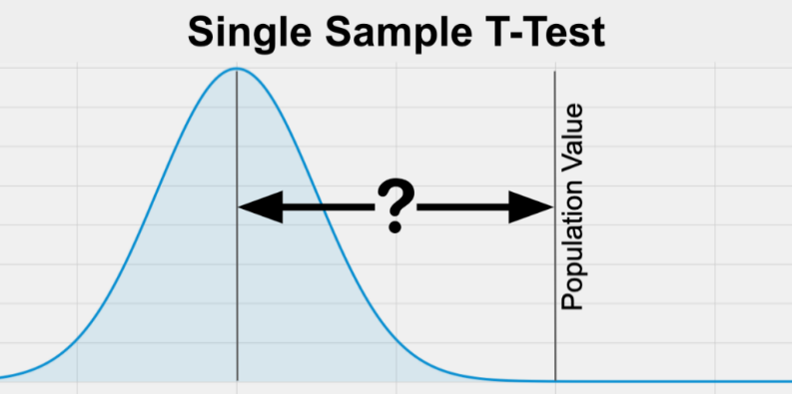
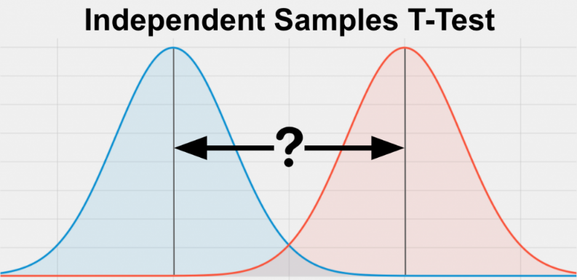
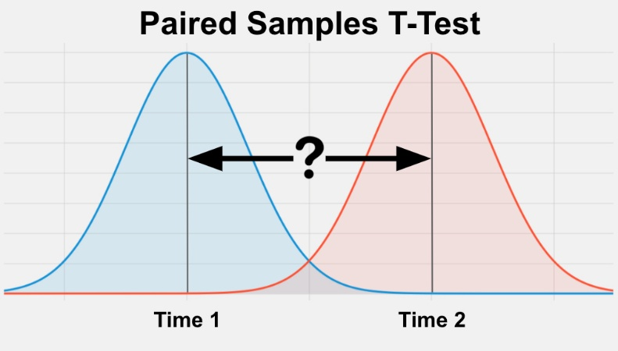
T-Tests are always
tests of whether the
difference is equal to zero
Diff: X - U
Diff: X2-X1
zero
Diff: T2-T1
Diff
∆=0

Slide 23
Estimators as T-Tests
Pre-Post w Comparison
Estimator
effect = (T2-T1) – (C2-C1)
Post-Only
Estimator
effect = T2-C2
Pre-Post Reflexive
Estimator
effect = T2-T1
Diff: T2-T1

Slide 24
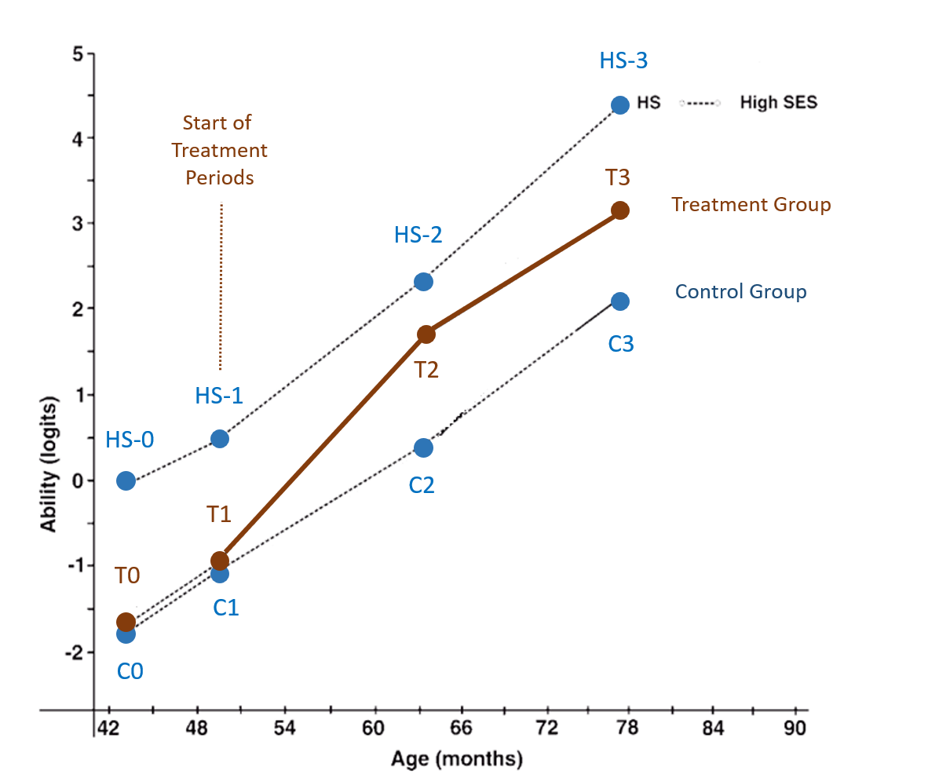

Slide 25
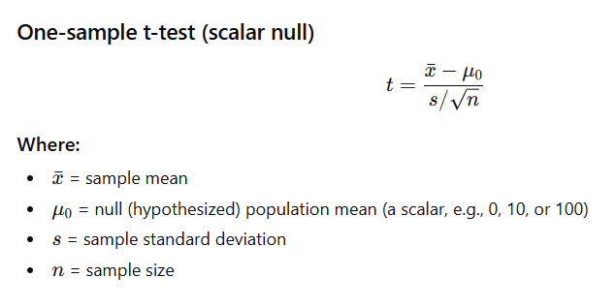

Slide 26
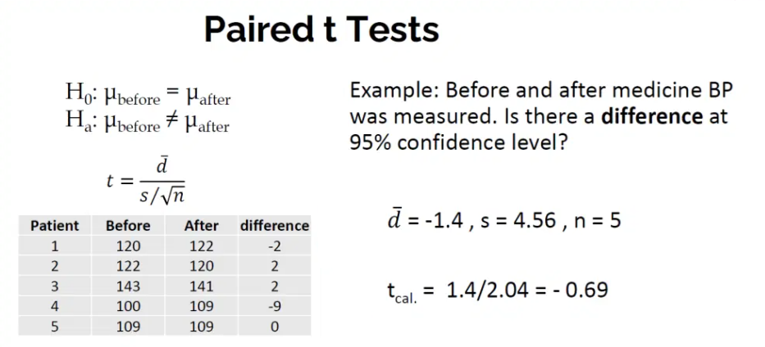
SD of the difference

Slide 27
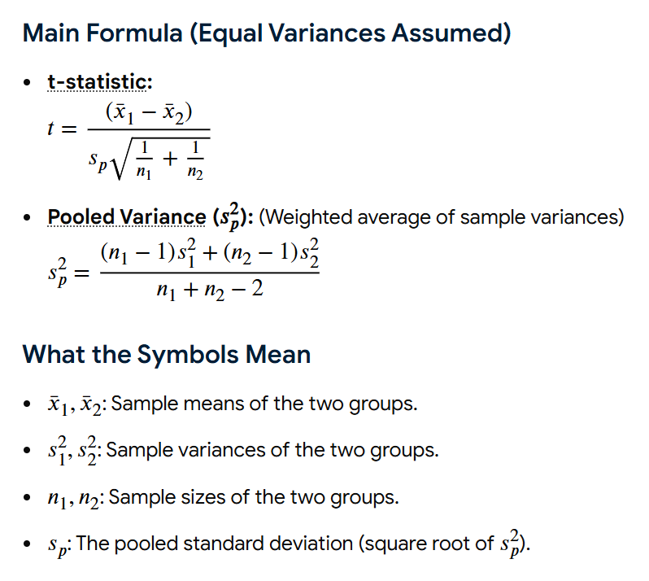

Slide 28
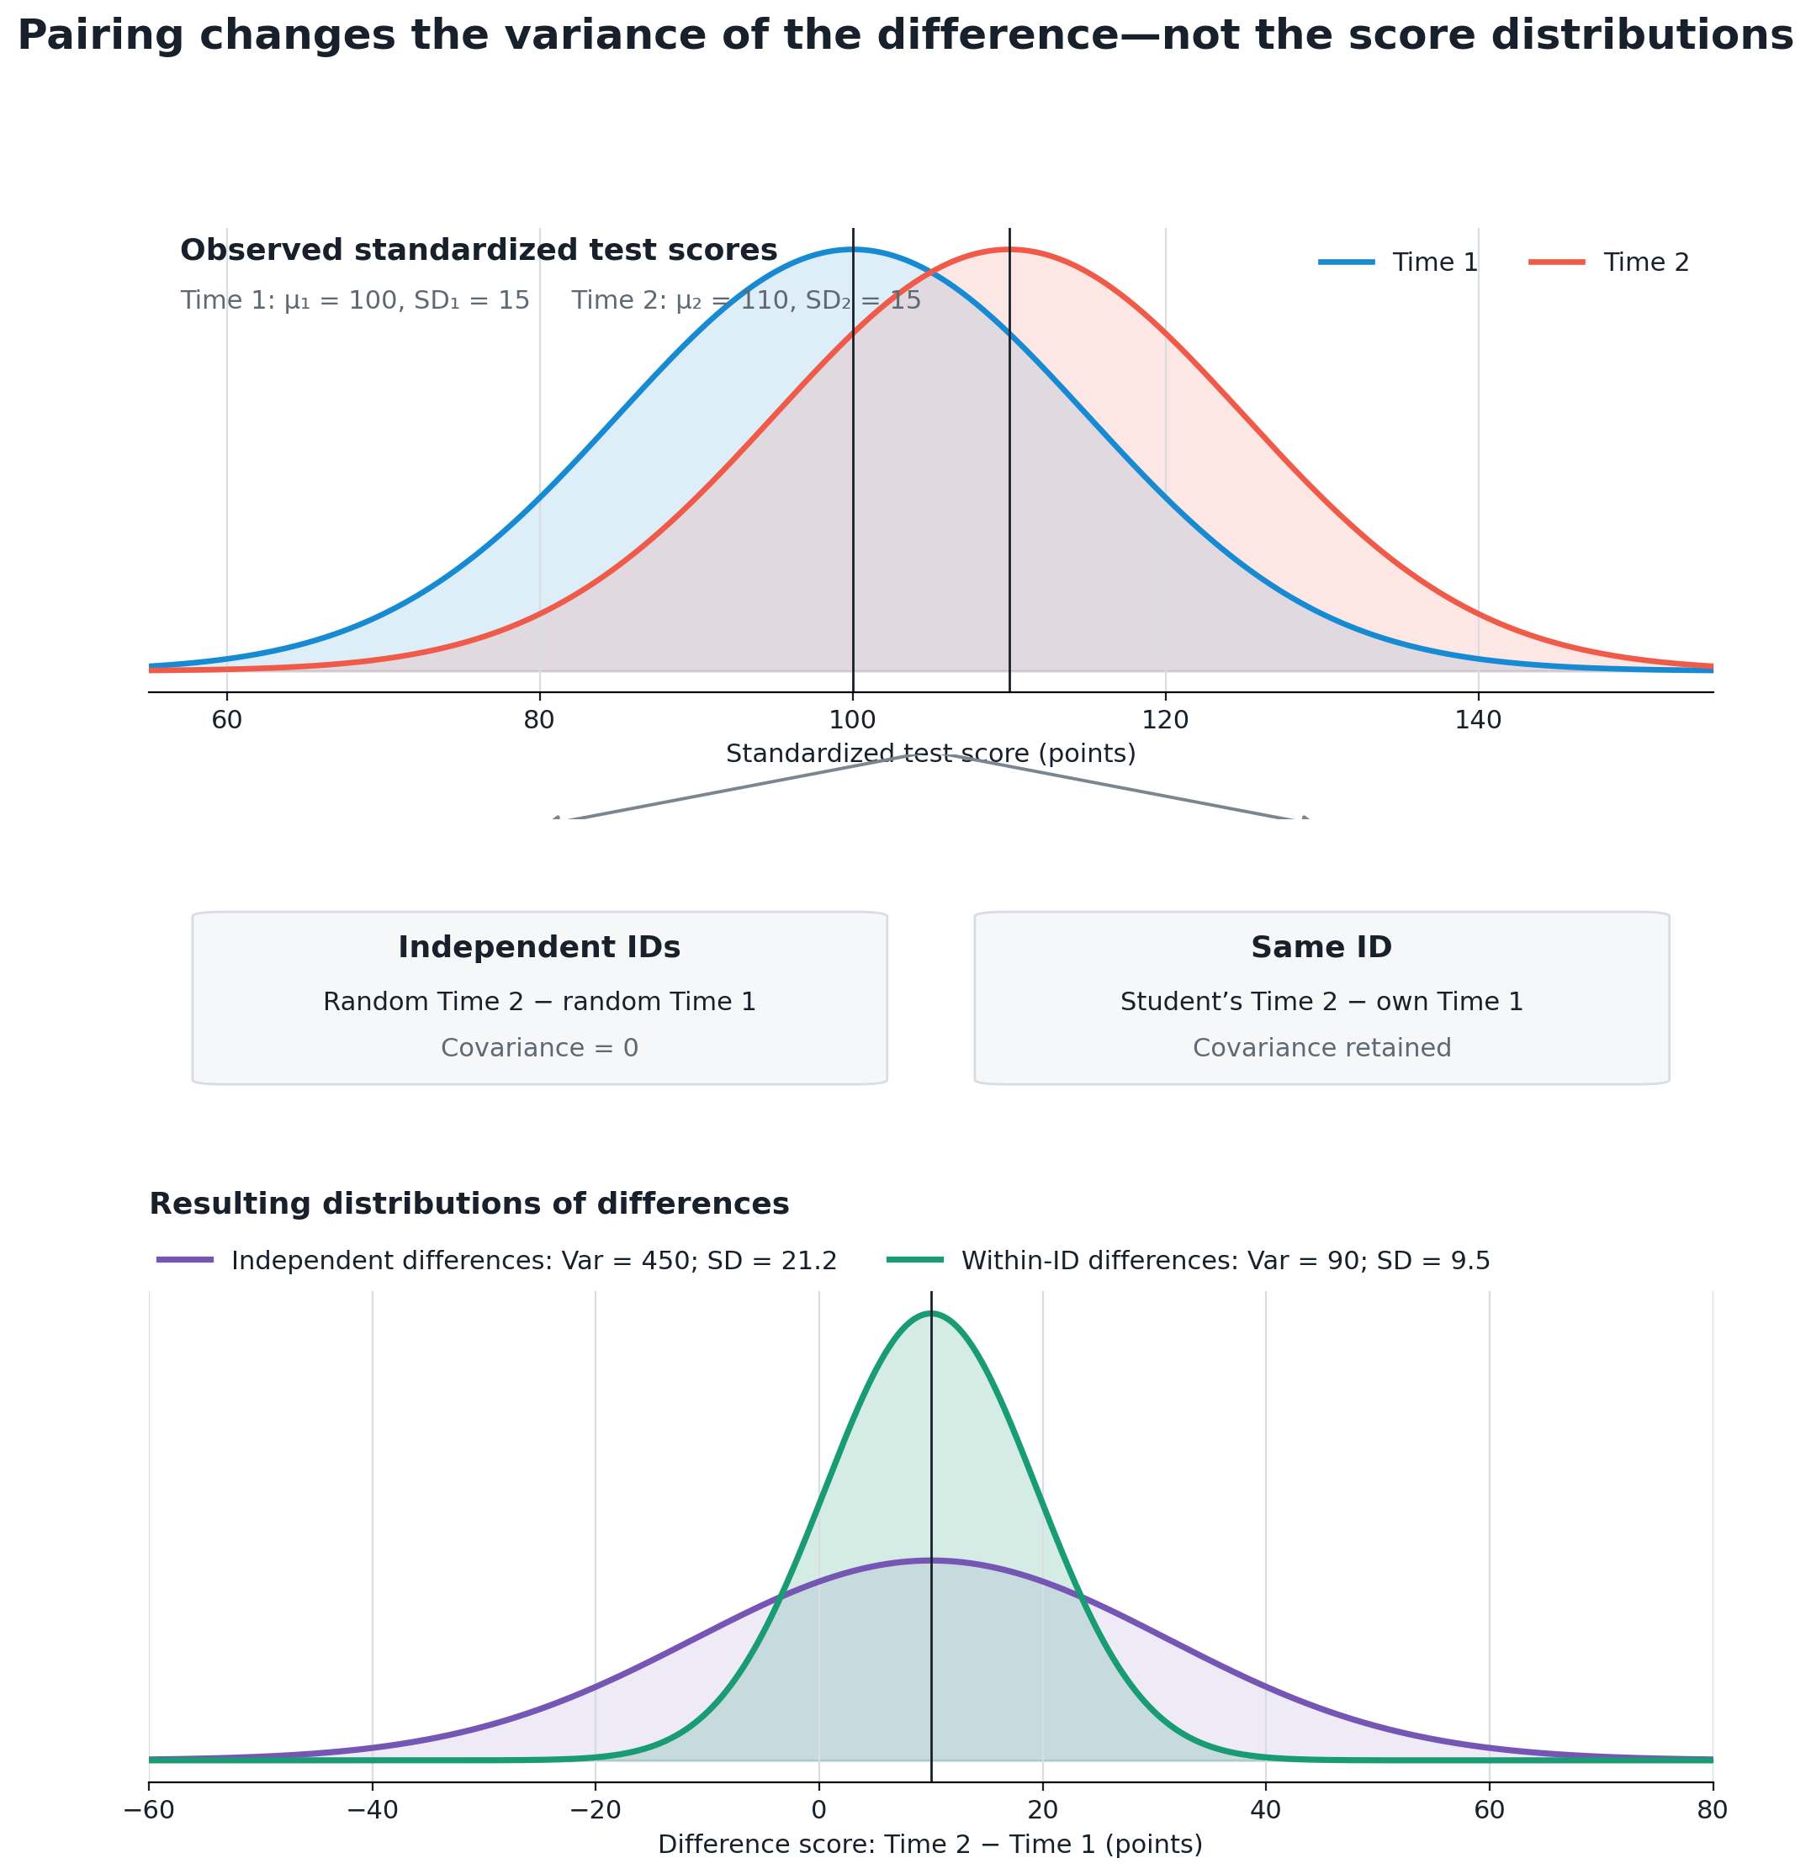
Panel data /
the reflexive estimator /
paired t-tests
(multiple observations
per ID)
have huge statistical power advantages

Slide 29
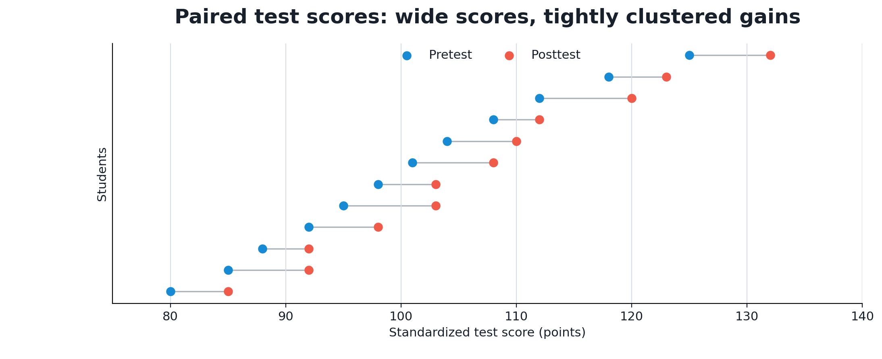

Slide 31

Formulas
s = sd(x)
s = pooled
s = sd(x2-x1)
Diff: T2-T1

Slide 32
AS REGRESSIONS
Y – null = b₀ + e
lm( y - mu ~ 1 )
Y = b₀ + b₁*D_treat + e
lm( y ~ treat_d )
Y_{it} = a_{i} + b*D_post + e_{it}
lm( y ~ post_d + factor(id) )
Diff: T2-T1

Slide 33
Connections to other topics:

Slide 34
3 valid counterfactuals:
Each variety of counterfactual has a different formula for the program effect estimate.
Pre-Post Reflexive
Estimator
effect = T2-T1
Post-Only
Estimator
effect = T2-C2
Pre-Post w Comparison
Estimator
effect = (T2-T1) – (C2-C1)
(Diff-in-Diff)
effect
effect
A
effect:
A-B
B
t=1
t=2
t=1
t=2
t=1
t=2
Program
Program
Program
Treatment Groups, T1=before, T2=post-program measure
Control Groups, C1=before, C2=post-program measure

Slide 35
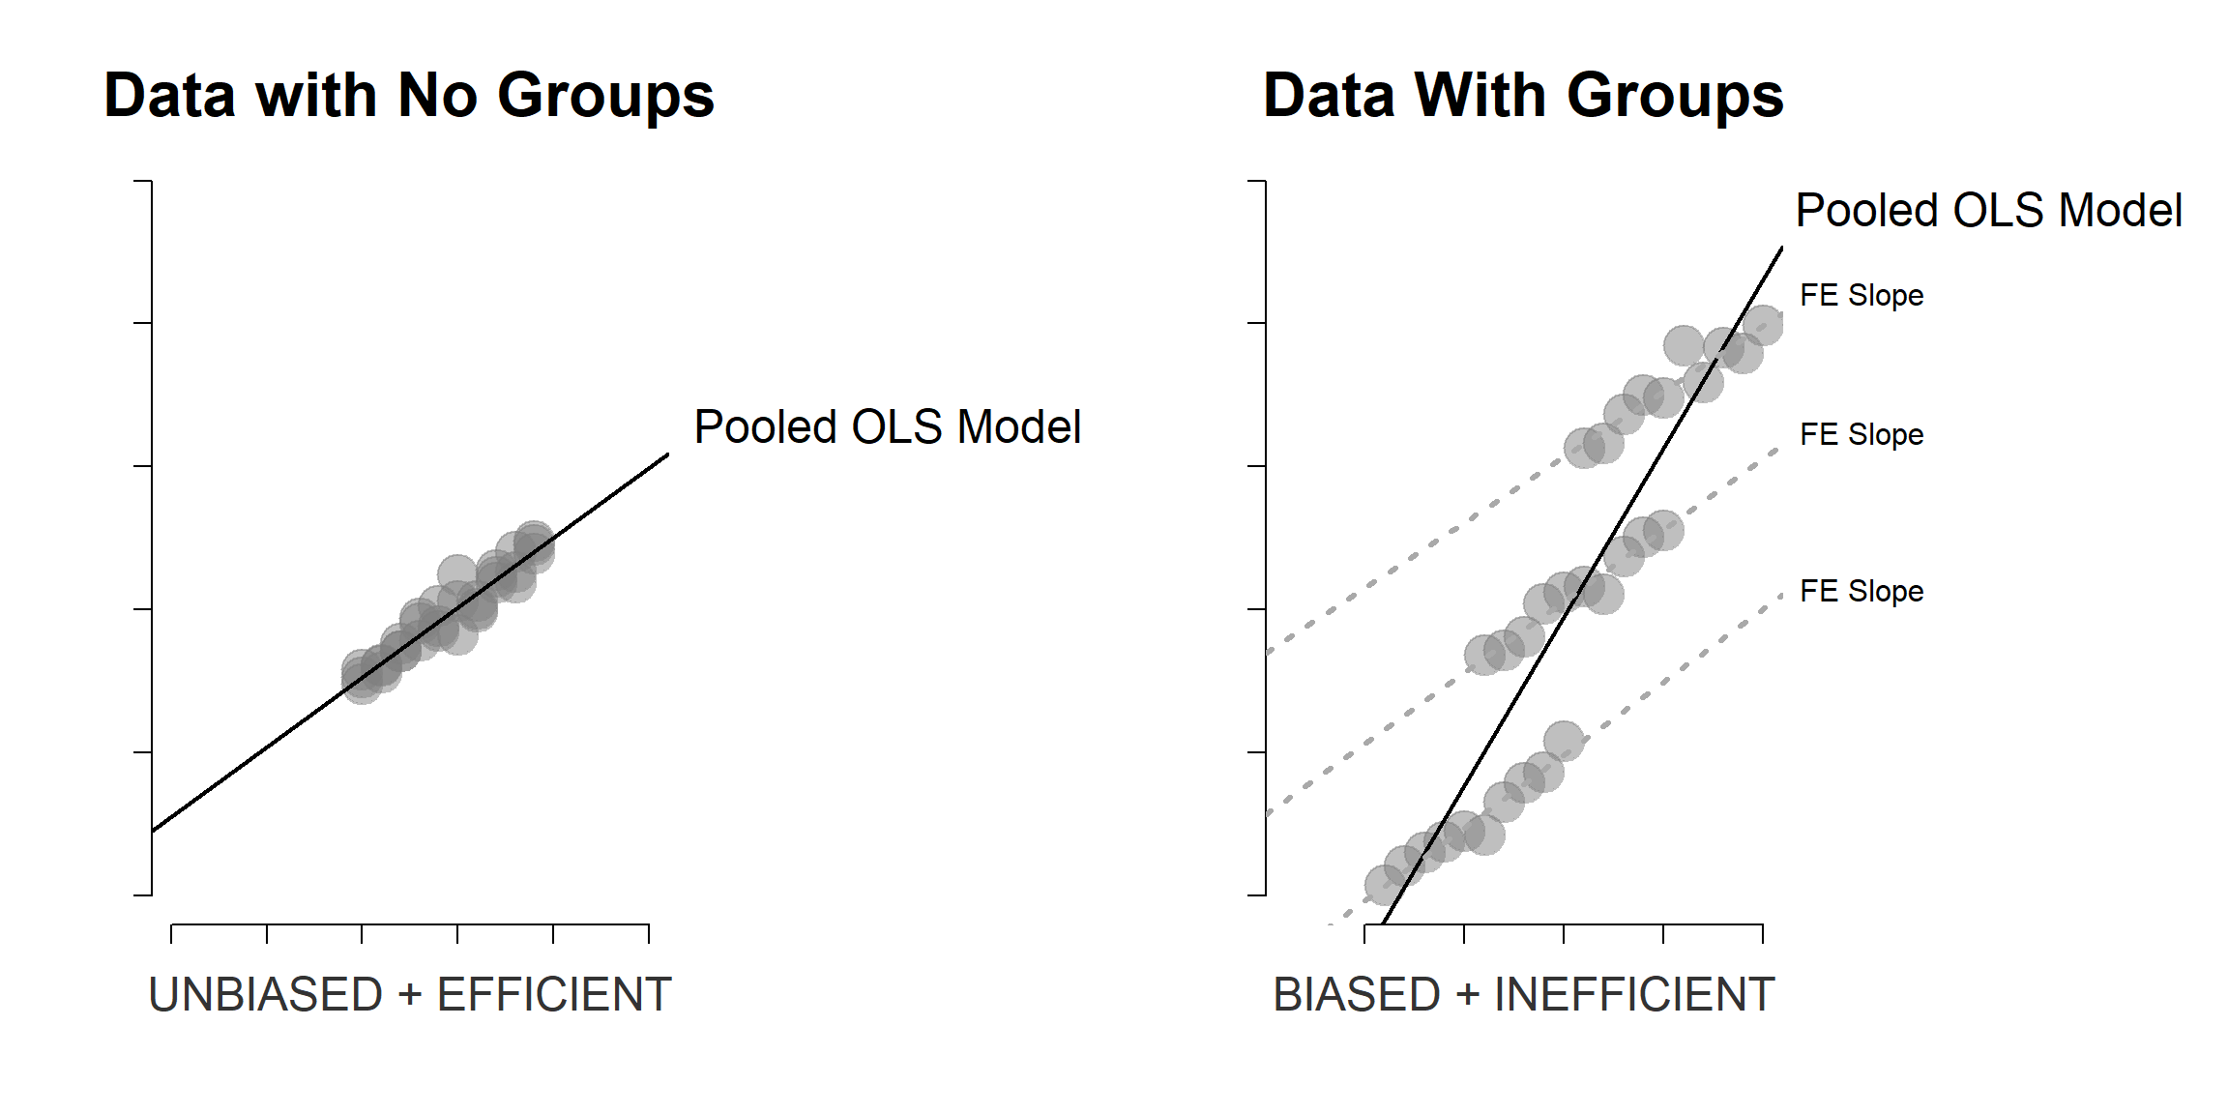

Slide 36
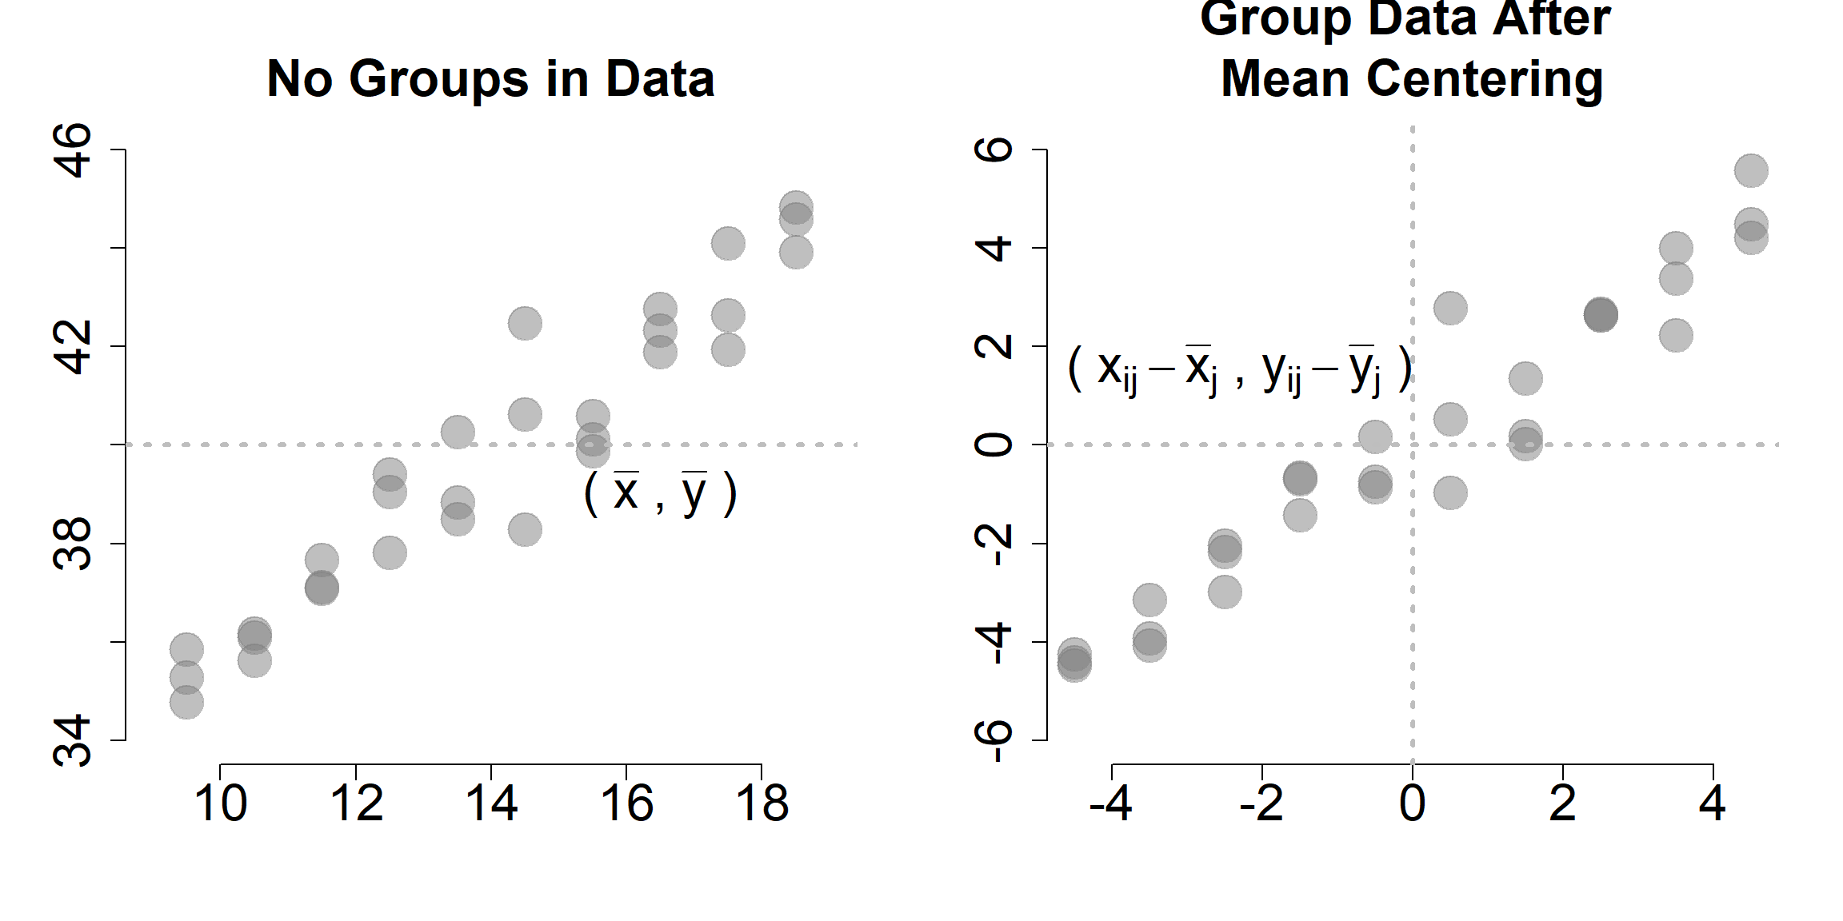
Note, this is just another partitioned regression approach where the control variable is the group ID

Slide 37
META-ANALYSIS

Slide 38
Standardized Mean Difference (SMD) vs. Standardized Mean Change (SMC)
Both the Standardized Mean Difference (SMD) and the Standardized Mean Change (SMC) express results in standardized units, allowing researchers to compare findings across studies. However, they apply to different research designs and interpret different forms of change.
1. Standardized Mean Difference (SMD)
The Standardized Mean Difference measures the difference between two *independent group means* in standardized units. It is used in between-subjects designs, such as comparing a treatment and control group.
Formula: SMD = (M₁ − M₂) / SDpooled
Where:
M₁ = Mean of treatment group
M₂ = Mean of control group
SDpooled = sqrt[(SD₁² + SD₂²) / 2]
Common estimators include Cohen’s d, Hedges’ g, and Glass’s Δ.
2. Standardized Mean Change (SMC)
The Standardized Mean Change measures the magnitude of change *within the same group* over time,
such as pre-test vs. post-test results. It is used in within-subjects or repeated-measures designs.
Formula: SMC = (Mpost − Mpre) / Sdpre
Common estimators include variants described by Morris & DeShon (2002), such as:
- Change standardized by the SD of change scores (dchange)
- Adjusted versions accounting for pre-post correlations

Slide 39
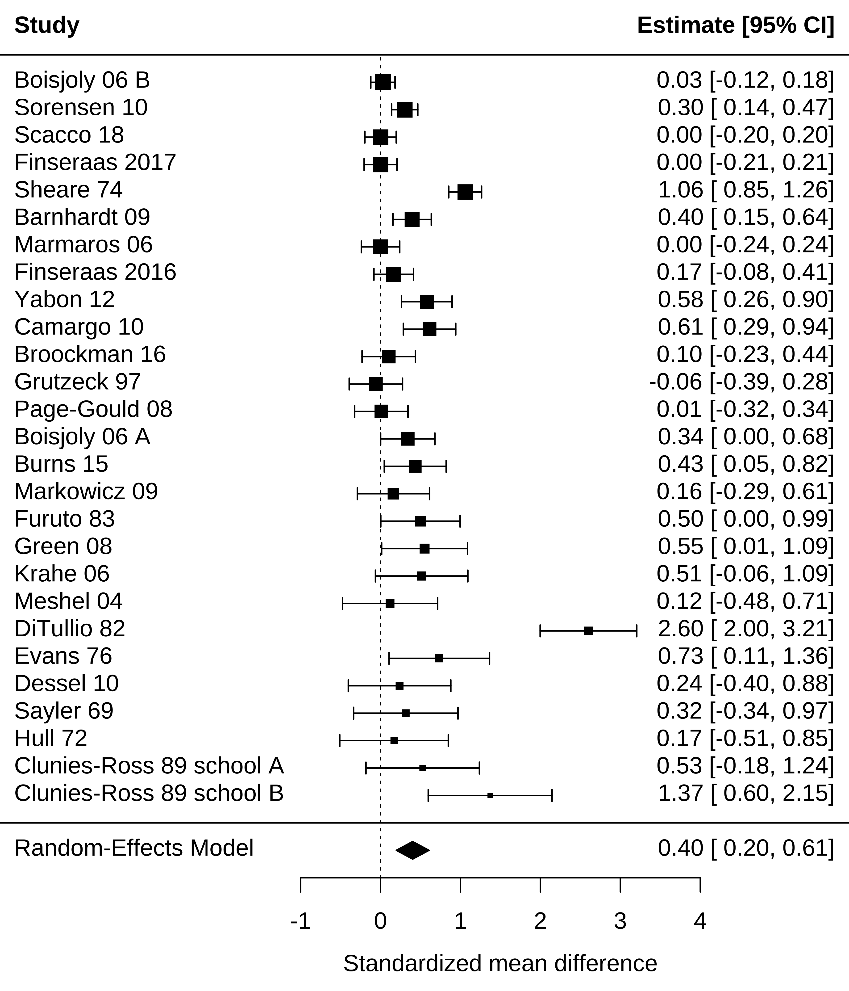
Research synthesis
Using meta-analysis
https://experimentology.io/016-meta.html

Slide 40

Figure 1: Various charts and plots common to meta-analysis.
https://www.nature.com/articles/nature25753

